Slide 1
Asynchronous Programming
Intro to Callbacks, Promises, and Observables.
Jeff Zotz and Micah Hauge

Slide 2
Asynchronous vs Synchronous Programming
Synchronous
Statements are executed in a sequence.
A synchronous operation blocks a process until the operation is completed.
Asynchronous
An asynchronous operation is non-blocking and only initiates the operation.
Async statements are not guaranteed to finish in any particular order.

Slide 3
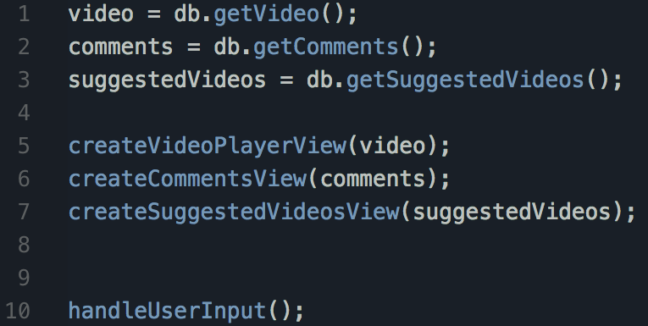
Synchronous Programming Example
Statements are executed and completed in order.
The method handleUserInput() will only be called when every other line has been executed

Slide 4
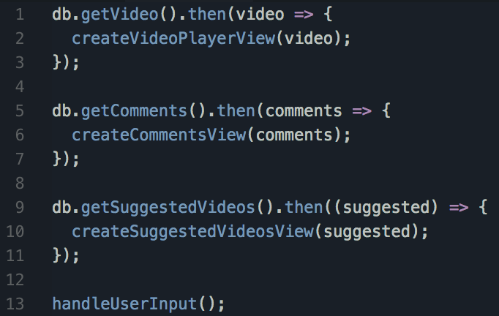
Asynchronous Programming Example
All statements start execution, but do not prevent following statements from executing.
The method handleUserInput() will be called almost immediately, since the other methods aren’t blocking execution.

Slide 5
Benefits of Asynchronous Programming
Major performance increases in some cases.
When developing user interfaces, it is possible handle user input while performing large operations.
Writing Asynchronous code can be significantly easier for the programmer than designing an algorithm to us parallel processing alone.
This is because the developer is not required to break the work up, spinup, and teardown threads needed.
It is now the standard for web development, so there are plenty of examples and resources.

Slide 6
When to use Asynchronous Methods
When to use an Asynchronous method:
Any time you are performing an operation that will take more than a few milliseconds.
Any time you are requesting data from an external service such as a database or an api.
When not to use Asynchronous method:
When the operation doesn’t take a long time (less than ~10 milliseconds)
When every operation in a program is dependant on the previous operation completing.

Slide 7
Behind the Scenes
The concept of synchronous vs asynchronous is not directly related to multithreading. A single or multithreaded task can be asynchronous.
Synchronous
Thread 1: | A | B | C
Single Threaded:
Thread 1: | A | B | C | A | C | A | B
Multi-Threaded:
Thread 1: | A
Thread 2: |  | B
Thread 3: |  |  | C

Slide 8
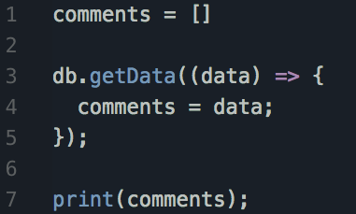
Common Problems
Race Conditions:
In this example, it isn’t guaranteed that comments will be loaded on line 7 when we attempt to print.

Slide 9
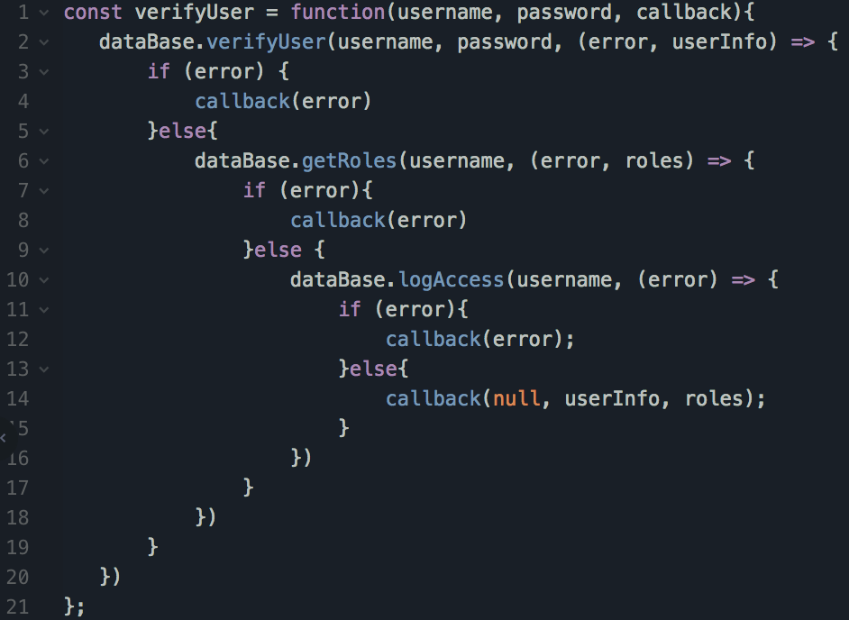
Common Problems
Nested Callbacks:
When performing more complex operations, nesting callbacks can produce ugly and difficult to read code.

Slide 10
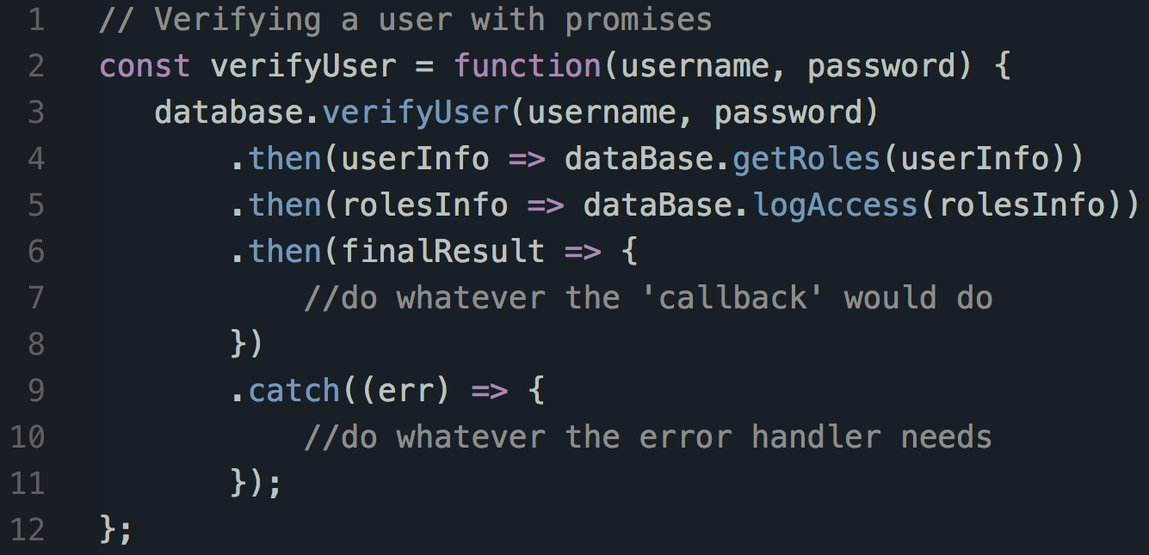
Solution: Promises
Promises:
Instead of specifying a callback at another indentation level, promises allow you to utilize promise chaining, making your code look simpler.

Slide 11
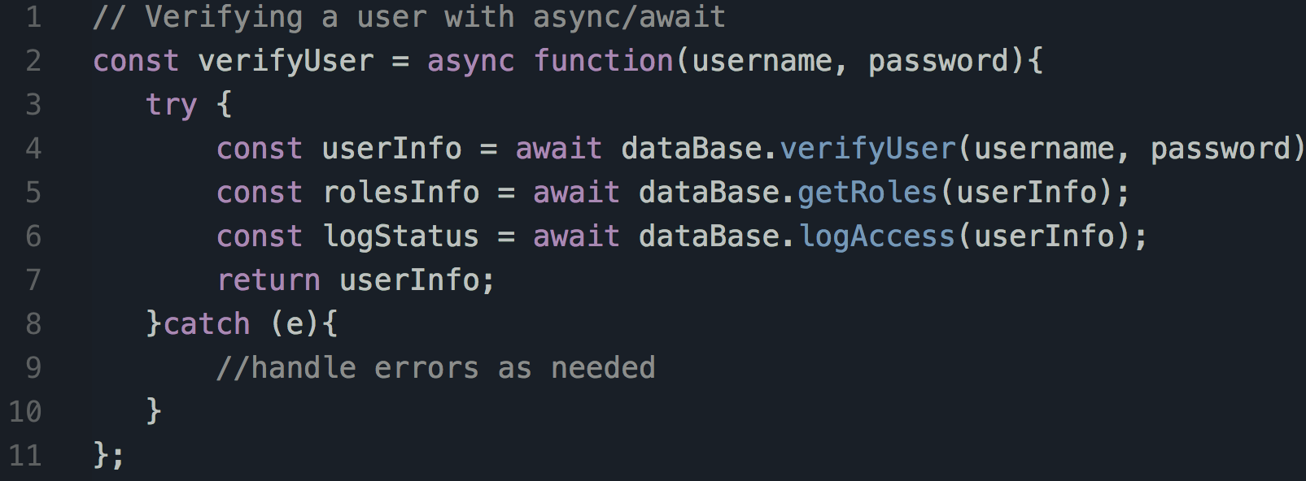
Solution: Async Await
Async Await:
Async await allows you to write asynchronous code in a similar fashion to synchronous code.

Slide 13
Solutions to Common Problems
Promises
Async await
Observables

Slide 14
Behind the Scenes
Single Threaded:
Thread 1: | A | B | C | A | C | A | B
Multi-Threaded:
Thread 1: | A
Thread 2: |  | B
Thread 3: |  |  | C

Slide 15
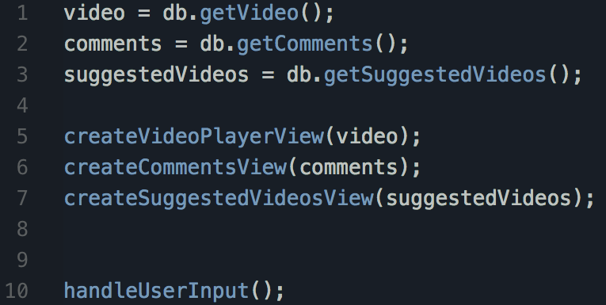
Synchronous Example:

Slide 16
 | A Start | B Start | C Start |  | C End | A End | B End
Single Thread: | A | B | C | A | C | A | B

Slide 17
Asynchronous vs Synchronous Operations
A synchronous operation blocks a process until the operation is completed.
An asynchronous operation is non-blocking and only initiates the operation.

Slide 18
Asynchronous vs Synchronous Operations
 | A Start | B Start | C Start |  | C End | A End | B End
Single Thread: | A | B | C | A | C | A | B

